Slide 1
Week 7: Comparing means (one-sample t test) PSYC121: Statistics for Psychologists
Dr Tom Beesley
t.beesley@lancaster.ac.uk

Slide 2
Objectives
Understand the need for a “parametric approach” to statistics
Understand that the process of sampling is “noisy” or “random”
Understand that increasing sample size reduces the effects of random sampling
Understand what a one-sample t-test does
Be able to calculate t and look up the value to check if it is significant

Slide 3

Do variables affect where data lie in the distribution of scores?
Do vegans drive more each week?
Do non-vegans drive less each week?
X = 45
Z = +.78
0
Miles driven per week
We want to make inferences about behaviour (e.g., driving) that we can measure, by looking at how that is influenced by other variables (e.g., being vegan) we have some control over.

Slide 4
Testing if variables affect behaviour
Inferential statistical tests help us to determine whether variables affect behaviour.
Is memory performance different in the morning vs. the afternoon?
Student | Morning | Afternoon | Size of improvement
Bob | 6 | 9 | +3
Jane | 8 | 7 | -1
Hanbit | 9 | 10 | +1
Ivanka | 4 | 5 | +1
Donald | 1 | 0 | -1
Joe | 6 | 8 | +2
 |  |  | Mean = 0.833

Slide 5
Populations and samples
These 6 scores are a sample of the population
We expect them to be a “representative sample”
How do we judge whether they are normal?
How unusual are these data?
Result | 6+ / 0- | 5+ / 1- | 4+ / 2- | 3+ / 3- | 2+ / 4- | 1+ / 5- | 0+ / 6-
Probability | 0.02 | 0.09 | 0.23 | 0.31 | 0.23 | 0.09 | 0.02

Slide 6

Our card sampling task
When there was a bias in the deck of cards:
Sometimes we got p < .05
But sometimes we didn’t p > .05
When our sample size was greater, our chance of success was greater.

Slide 7
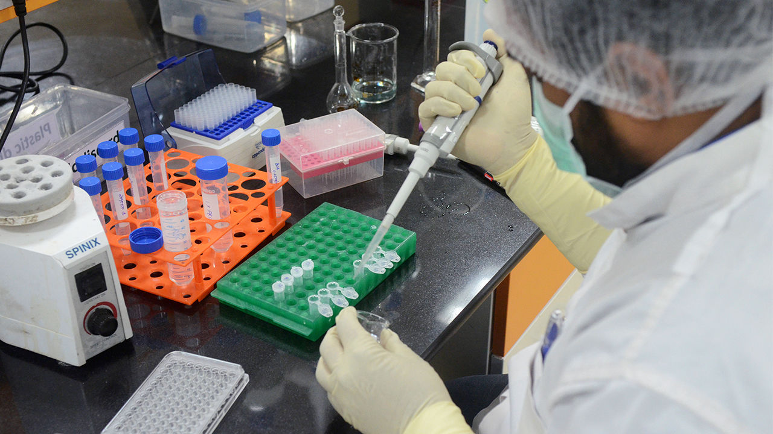

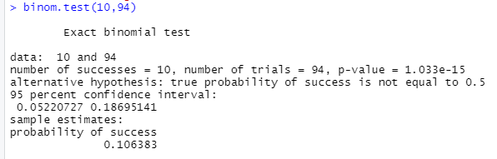
Placebo (no drug) ~ 84
Vaccine ~ 10

Slide 8
Parametric vs. non-parametric
Student | Morning | Afternoon | Size of improvement | Direction of change
Bob | 6 | 9 | +3 | +
Jane | 8 | 7 | -1 | -
Hanbit | 9 | 10 | +1 | +
Ivanka | 4 | 5 | +1 | +
Donald | 1 | 0 | -1 | -
Joe | 6 | 8 | +2 | +
 |  |  | Mean = 0.83 | 4 positive / 2 negative
Null hypothesis
0.83
0
Student | Morning | Afternoon | Size of improvement | Direction of change
Bob | 3 | 9 | +6 | +
Jane | 8 | 7 | -1 | -
Hanbit | 2 | 10 | +8 | +
Ivanka | 1 | 10 | +9 | +
Donald | 1 | 0 | -1 | -
Joe | 2 | 8 | +6 | +
 |  |  | Mean = 4.5 | 4 positive / 2 negative
Null hypothesis
4.5
0

Slide 9
Sampling from a distribution
Demo of sampling process in R…

Slide 10
Simulation – take home messages
There is an underlying “population” of data
Often normally distributed, with a true population mean
We draw representative samples; we estimate the population mean
The process of sampling introduces randomness
Our sample mean will vary, from one experiment to the next
With small samples, the variance of sample means is higher
With large samples, the variance of sample means is lower

Slide 11
Sampling and sample means
For each sample, we get different results
Sometimes “very normal” (our mean ~= the population mean).
Sometimes “abnormal” (our mean ≠ the population mean).
0.8
4.5
0

Slide 12
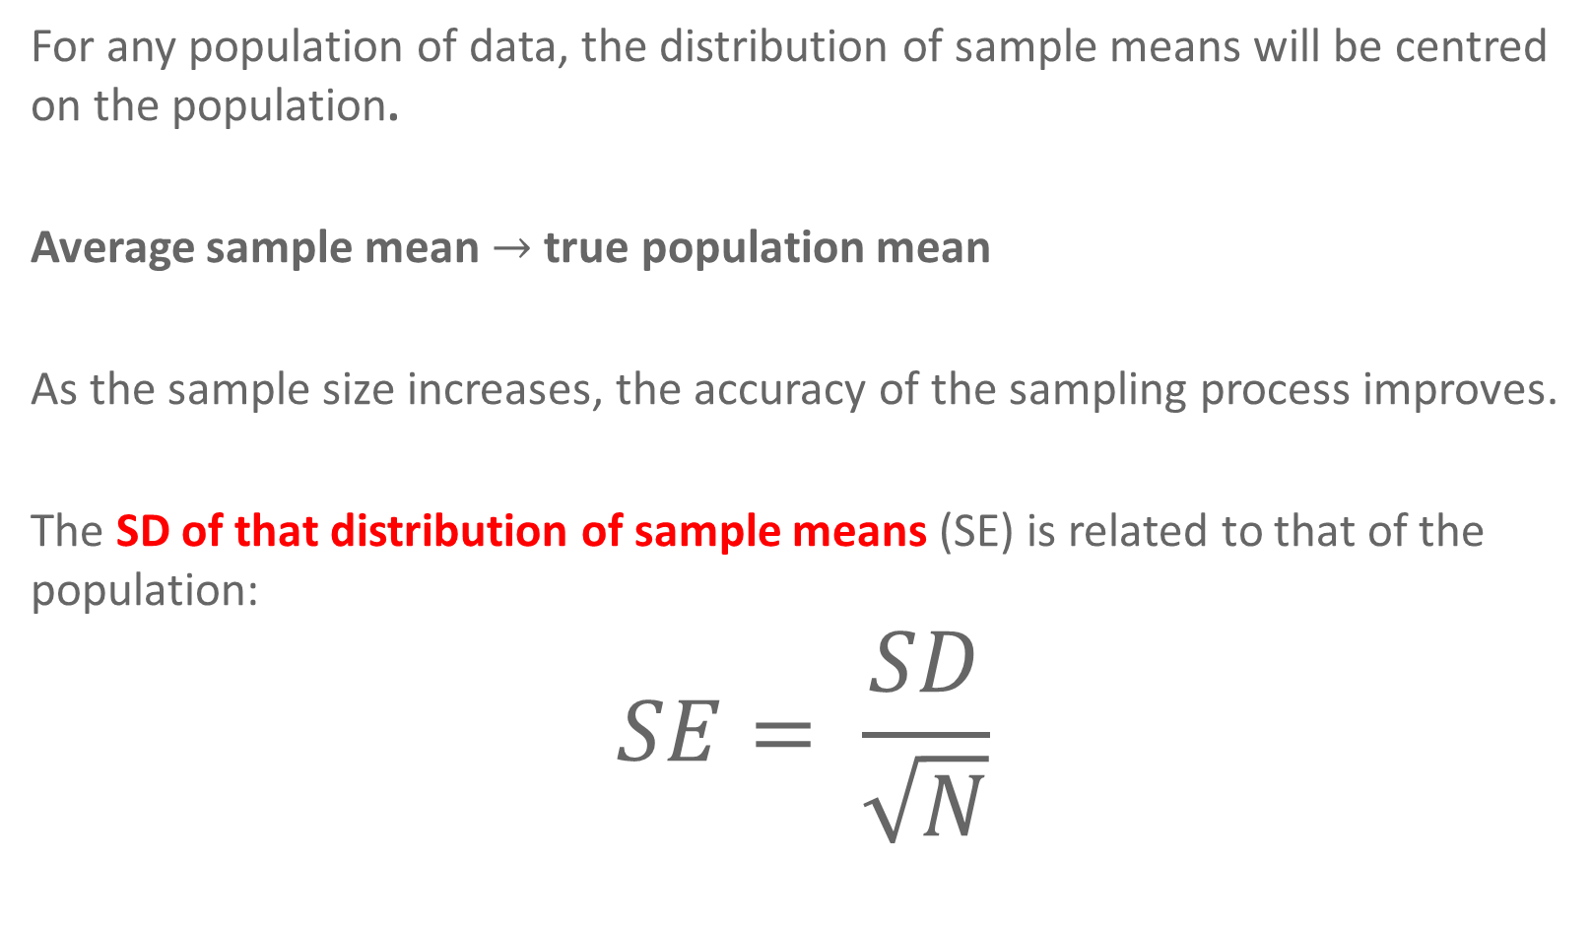
Central Limit Theorem
For any population of data, the distribution of sample means will be centred on the population.
Average sample mean $→$ true population mean
As the sample size increases, the accuracy of the sampling process improves.
The SD of that distribution of sample means (SE) is related to that of the population:
$$SE= \frac{SD}{\sqrt{N}}$$

Slide 13
Hypothesis testing
OK, so why is the CLM important?
It is VERY important. It tells us that the most likely mean that our sample will produce is the population mean. More extreme events are less likely.
THIS IS CRUCIAL!!!
It allows us to make statistical inferences about what the data should look like under the null hypothesis (H₀).
We need to determine whether our sample mean is unusual (expected under the null hypothesis) – how do we do that?!...

Slide 14
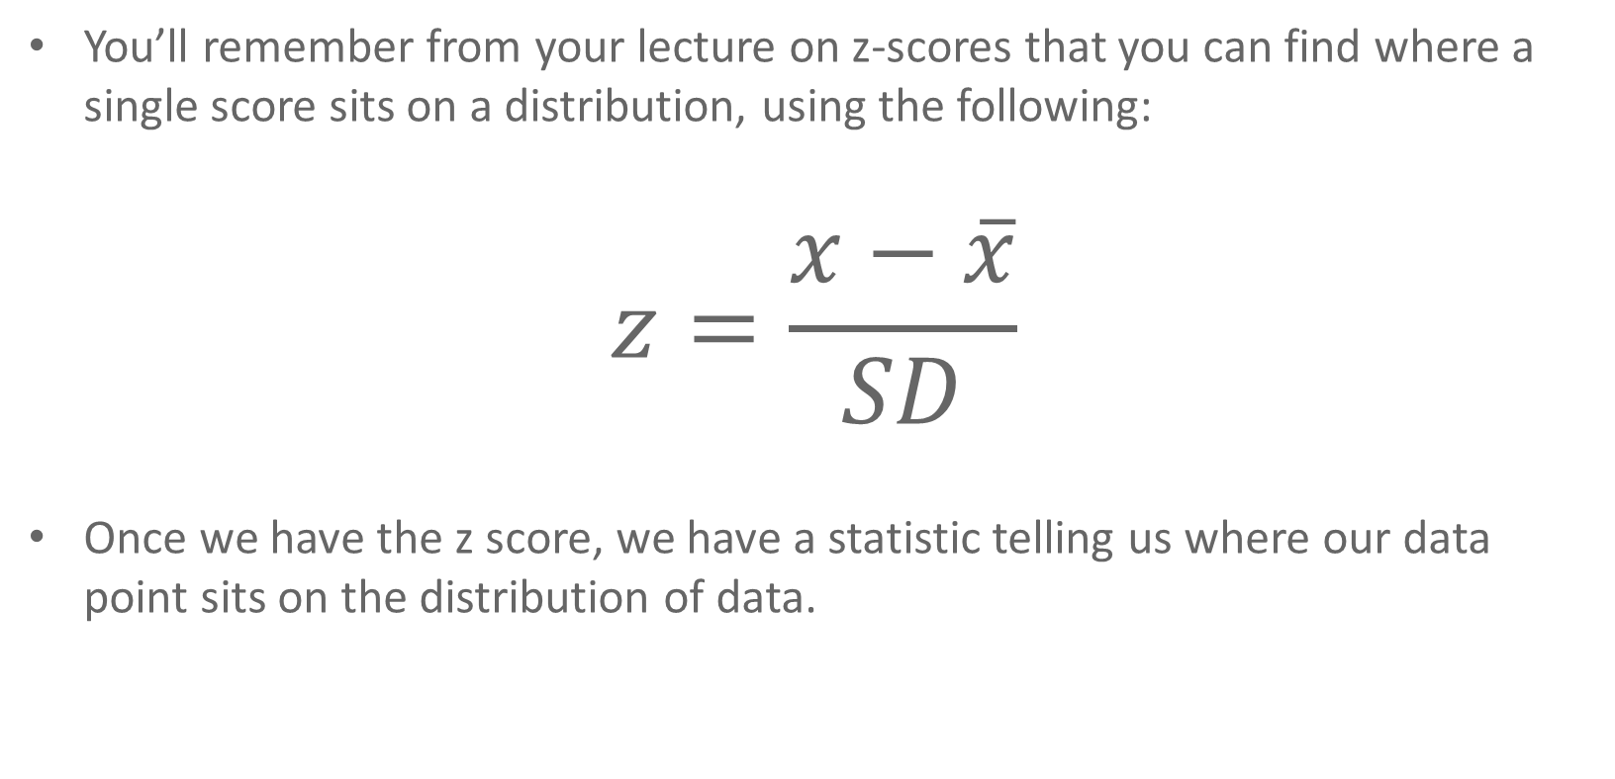
Hypothesis testing Z-scores - recap
You’ll remember from your lecture on z-scores that you can find where a single score sits on a distribution, using the following:
$$z=\frac{x−\overline{x}}{SD}$$
Once we have the z score, we have a statistic telling us where our data point sits on the distribution of data.

Slide 15
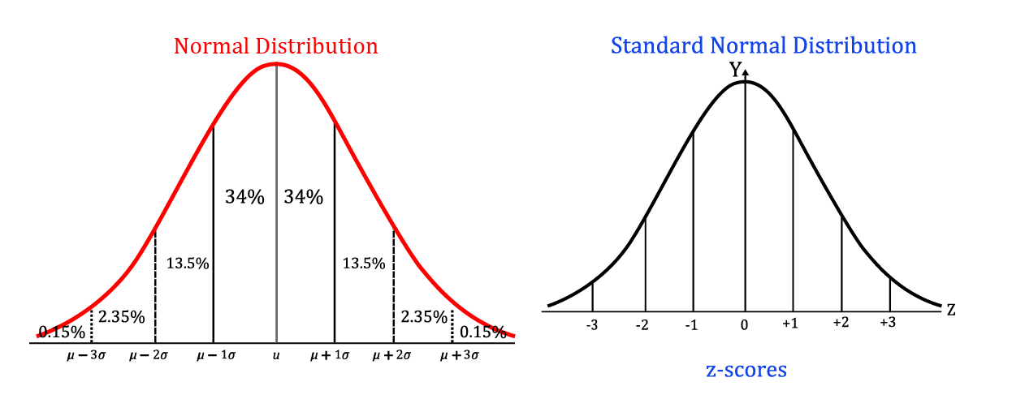
Hypothesis testing Z-scores, to recap

Slide 16


Hypothesis testing Testing means
When we want to understand (or “test”) a mean of a sample (rather than just one data point), we can use a very similar formula:
$$z=\frac{\overline{x}−μ}{SE}$$
$$z=\frac{x−\overline{x}}{SD}$$
The relationship of a sample mean to the distribution of sample means.
The relationship of a single data point to distribution of data.

Slide 17
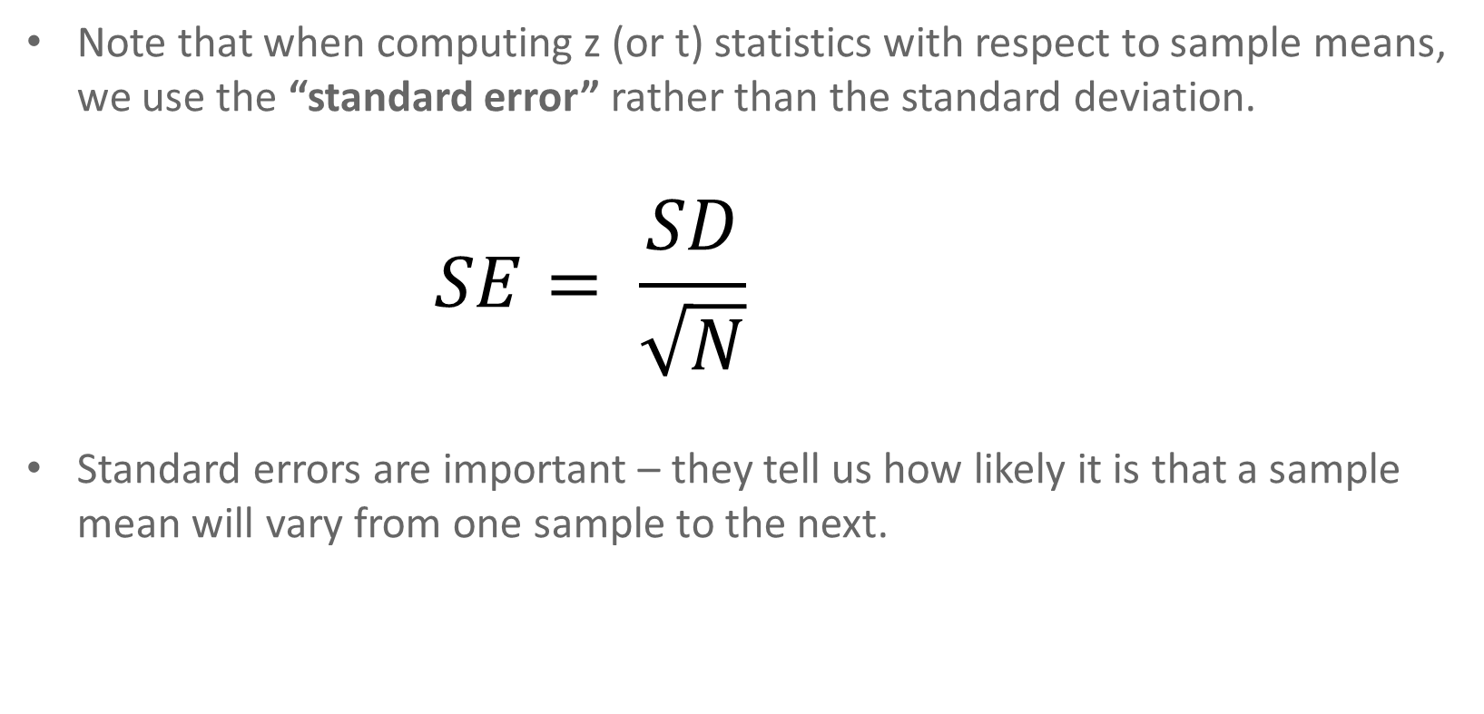
Hypothesis testing Standard error
Note that when computing z (or t) statistics with respect to sample means, we use the “standard error” rather than the standard deviation.
$$SE= \frac{SD}{\sqrt{N}}$$
Standard errors are important – they tell us how likely it is that a sample mean will vary from one sample to the next.

Slide 18
Summary so far
Samples we draw will vary in the means they produce
But, this distribution of samples means will be normal and centred on the true population mean
We can estimate the variance in sample means
We can use this to calculate a z-score for our sample mean
This tells us how unusual our sample mean is.

Slide 19
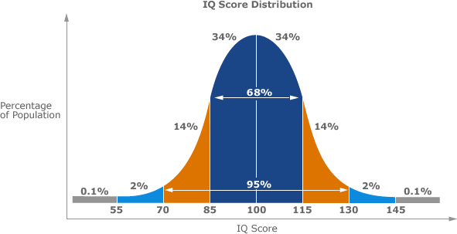
Calculating z for sample means …an example
In many cases we don’t know the underlying population mean, but sometimes we do:
For example, IQ:
IQ is a standardised metric of intelligence, with a mean of 100 and a standard deviation of ~15.
Using C.L.T, we know that random samples drawn from this population will have a mean of 100.

Slide 20
Calculating z for sample means …an example
Hypothesis: Lancaster University students have above average intelligence.
We collect a sample of IQ scores from 10 students and we find that their mean is 110.
We can test if this sample is extreme in terms of samples drawn when the null hypothesis is true.
The SD for IQ = 15, so our SE = 15 / √10 = 4.74

Slide 21
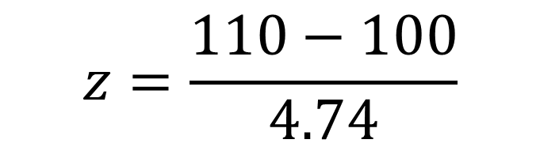
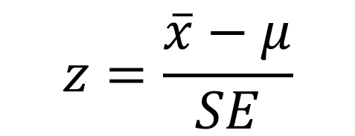

Calculating z for sample means …an example
$$z=\frac{\overline{x}−μ}{SE}$$
$$z=\frac{110−100}{4.74}$$
$$z=2.1$$
What this tells us, is that the effect in our sample is 2.1 times the standard deviation of the sample means (the standard error).
The z table tells us that this sample mean is in the top 2% of means expected from a sampling distribution with mean of 100 and SE of 4.74.

Slide 22


Testing means when the variance is unknown
Let’s consider another example….Hypothesis: Lancaster University students can discriminate the sex of dogs by looking at facial features.

Slide 23
Testing means when the variance is unknown
This is more tricky, since we don’t know certain key bits of data.
Without any baseline data, we are missing two things for our test:
The mean of the population.
The standard deviation of the population.

Slide 24
Testing means when the variance is unknown
Remember that we are testing our data against the null hypothesis.
This allows us to set the expected population mean (under the null hypothesis).
Our alternative hypothesis was: Lancaster University students can discriminate the sex of dogs by looking at facial features.
Let’s say we have pictures of 10 male dogs and 10 female dogs
What is the null hypothesis?

Slide 25

Testing means when the variance is unknown
So the mean score for our population (under the null hypothesis) is 0.5 (chance performance).
What about the standard deviation?
We can use the standard deviation of the sample to calculate standard error.
$$SE= \frac{SD}{\sqrt{N}}$$

Slide 26

And SD changes a little here too…
When calculating SD for a sample, we are actually “estimating the standard deviation”
$$SD= \sqrt{\frac{\sum{{\left(X−\overline{X}\right)}^{2}}}{N−1}}$$
The SD of a sample uses N-1

Slide 27
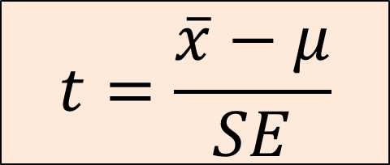
The t statistic
When we do not know the actual population variance, we can no longer use the z distribution.
This is because sample variance tends to underestimate population variance, especially for small N (just trust the statisticians).
Thankfully, we can evaluate against a different distribution that takes this into account.
This is known as t. We use a t-test, and this is computed in the same way.
$$t=\frac{\overline{x}−μ}{SE}$$

Slide 28
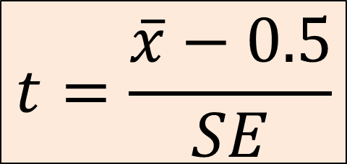
One-sampled t-test
In this example we are interested in conducting a one-sample t-test.
We compare the sample mean to a test score.
Our test score comes from our null hypothesis: Lancaster University students cannot discriminate the sex of dogs by looking at facial features.
$$t=\frac{\overline{x}−0.5}{SE}$$

Slide 29
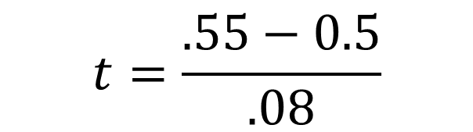

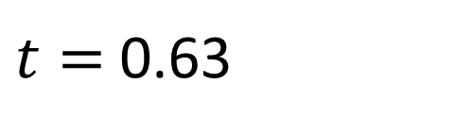
One-sampled t-test
Let’s say a sample of 10 participants produces a mean is 0.55 (they correctly sex the dogs on 55% of trials).
Let’s also say the standard deviation of the scores of this sample is .25.
So our standard error is .25/√10 = .08
$$t=\frac{\overline{x}−0.5}{SE}$$
$$t=\frac{.55−0.5}{.08}$$
$t=$ 0.63

Slide 30
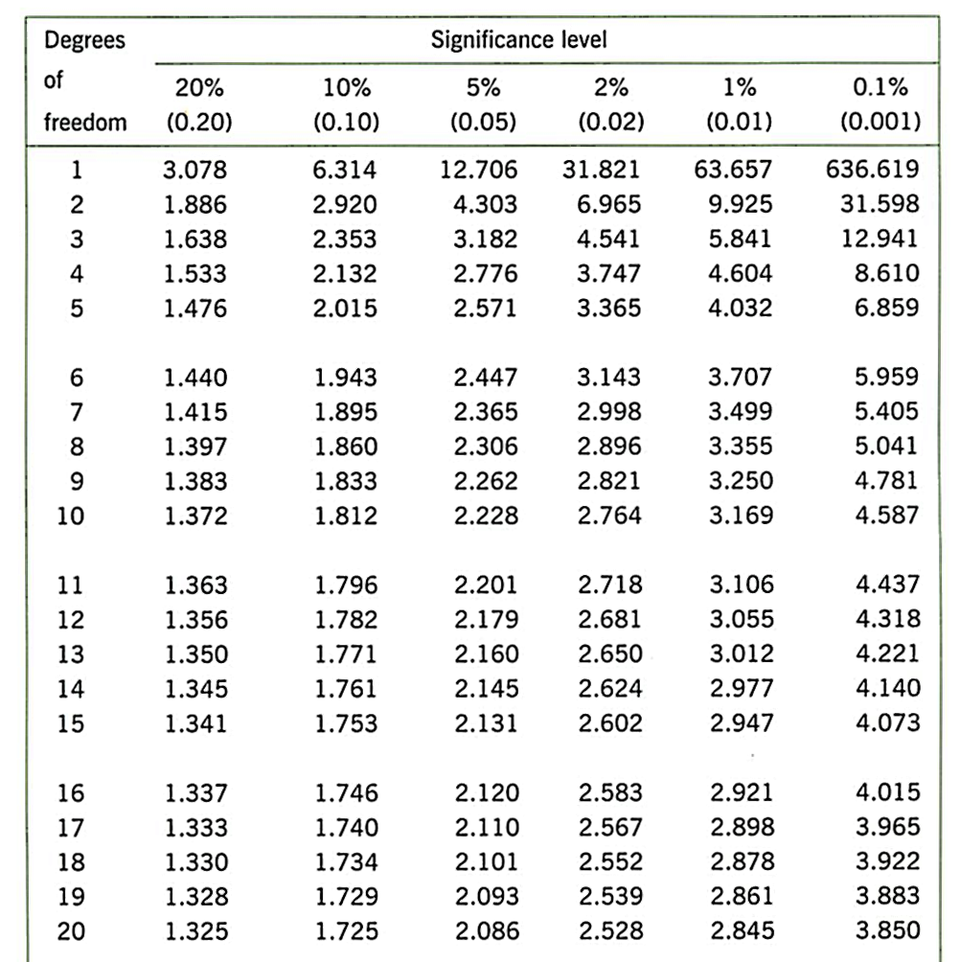
Is our t value significant?
We calculate the “degrees of freedom”
df for one-sample t-test is (N-1)
df = 10-1 = 9
So the critical value is 2.26 (two tailed) at the 5% level.
Our t was 0.63…not significant.

Slide 31
How would be write this?
If you wanted to report this, you would write:
“It was found that Lancaster University students were unable to discriminate the sex of dogs by looking at their facial features, t(9) = 0.63, p > .05.”
If you’ve done this in R (see lab) and you have a precise p value, then you should report that.

Slide 32
Significant at 5%?
What does this statement mean?
It means that, should we find a t value that exceeds our criterion value, then the probability of the data, given the null hypothesis (H₀) is less than 5%.
Remember! We can never be absolutely certain in a result
However, we can express our uncertainty as a probability and accept that we may be wrong sometimes
(see Lecture 1: Type 1 & 2 errors).

Slide 33
Summary
We can test if the mean of our sample is different to what we would expect under the null hypothesis
If it is different, then we will get large values of t (positive or negative)
The probability of large t values (>+2, <-2), under the null hypothesis is quite small.
So when we see these values, we can reject the null hypothesis (the probability of the data under the null is less than 5%; p < .05)

